Slide 1
DRAFT
THIS DECK IS STILL DRAFT

Slide 2
Presentation Notes
This entire deck, including demos but not the checkpoints, must be delivered in 10 minutes or less. Participants need time to do the actual lab.
Talking points are very brief. Even if you’ve seen the same slide in the past, take note of the new talking points.

Slide 4
Introduction to Microsoft Azure IoT with Windows 10 IoT Core
Code Labs

Slide 5

Disruptive Forces Enabling IoT
Moore’s Law
Metcalf‘s Law
Koomey’s Law
Transistors
Computations
per KWh
10,000,000,000
1.E+14
1,000,000,000
1.E+12
100,000,000
1.E+10
10,000,000
1.E+08
1,000,000
1.E+06
100,000
1.E+04
10,000
1.E+02
1,000
1.E+00
1970
1980
1990
2000
2010
1940
1975
2010
And more importantly:
what can you do by combining and analyzing signals from all of these IoT devices?
Notes:
“Moore’s law tells us that computers are still getting more powerful. Koomey’s law tells us that they also require a lot less power than they did in the past. And Metcalf’s law observes that computers are more valuable when they are more connected. All of these things apply directly to, and in fact enable, IoT.”
Reference:
The graphs are illustrations, not exact values
Moore's law is the observation that the number of transistors in a dense integrated circuit doubles approximately every two years.
Metcalfe's law states that the value of a telecommunications network is proportional to the square of the number of connected users of the system (n²).
Koomey’s law describes a long-term trend in the history of computing hardware. The number of computations per joule of energy dissipated has been doubling approximately every 1.57 years. This trend has been remarkably stable since the 1950s (R² of over 98%) and has actually been somewhat faster than Moore’s law. Jonathan Koomey articulated the trend as follows: "at a fixed computing load, the amount of battery you need will fall by a factor of two every year and a half."

Slide 6
IoT is gaining momentum
2010
Alarm clock
Refrigerator
Automobile
VoIP phone
Computer
Printer
Media player
Microwave
HOME
WORKPLACE
HOME
Coffee maker
Smart scale
Oven
Cell phone
HVAC
Vending
Security
Television
Notes:
“IoT is gaining momentum. Back just a few years ago, the uses for IoT were pretty limited. Mostly smart embedded devices doing PC-like things, as well as many of the scenarios carried over from decades of embedded computing.”

Slide 7
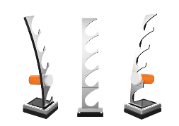
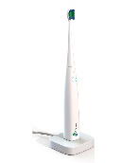
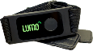
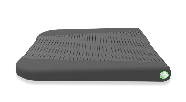
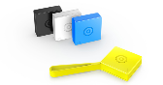
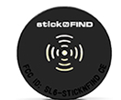
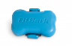

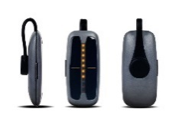
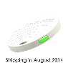
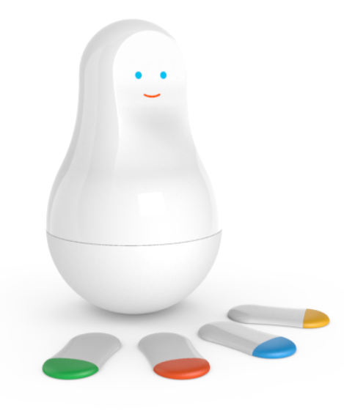
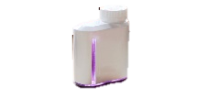

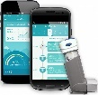
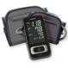
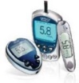
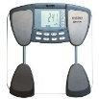
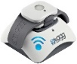
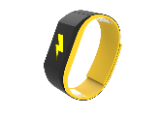
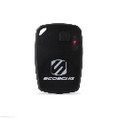
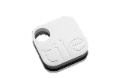
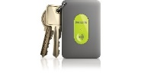
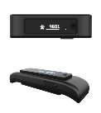
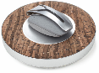


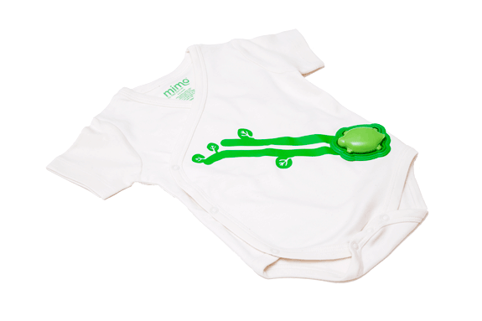
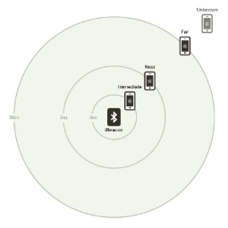
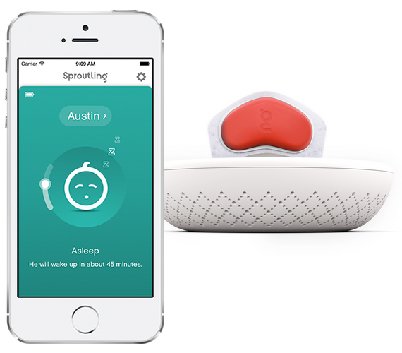


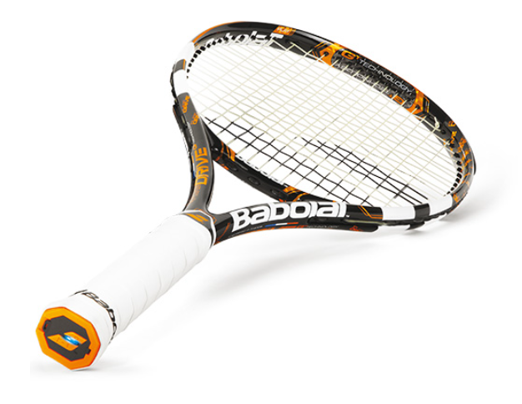
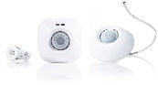
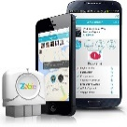
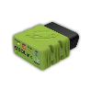
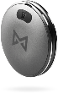
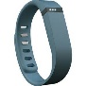
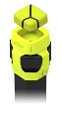
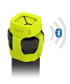
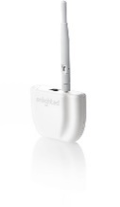
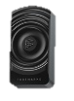

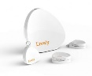
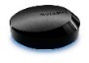
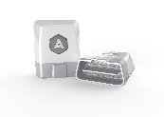
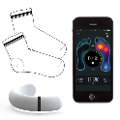
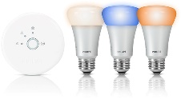
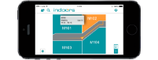
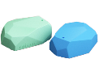
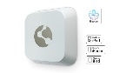
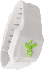
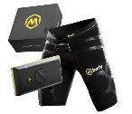
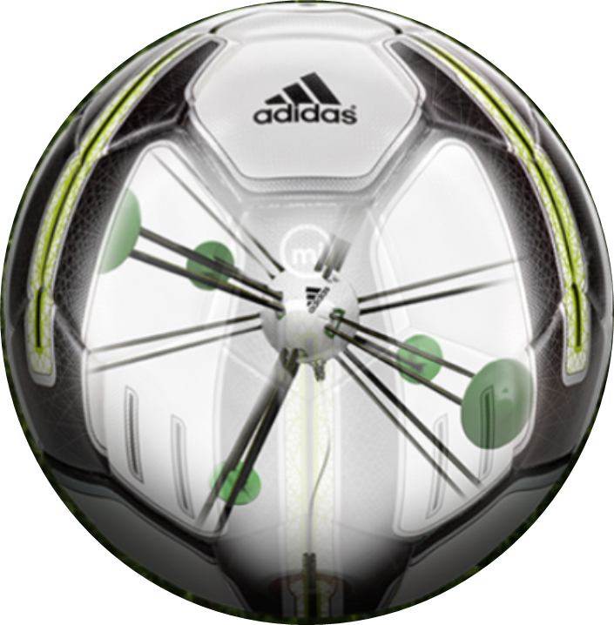


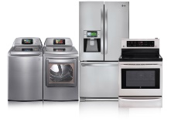
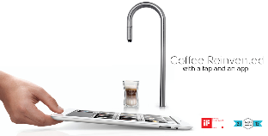
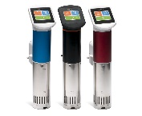
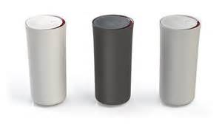












































Medication adherence
Health monitoring
Pet tracking
Behavior modification
Object tracking
Child and elder monitoring
Sports and fitness
Indoor navigation
Trip tracking and car health
Smart lighting
Beacons and proximity
COMMUTE
COMMUTE
HOME
WORKPLACE
HOME
Smart appliances
Food and nutrition tracking
Identity
Office equipment
Smart vending machines
Bike ride stats and protection
Air conditioning and temperature control
Sleep tracking
Environmental sensors
Information capture
Control
Home security
Home automation
Leak detection
Garden, lawn and plant care
New devices and sensors
Entertainment systems
Notes:
“But today, we’re seeing IoT everywhere, with devices that are smarter because they are both more powerful and more connected.”

Slide 8
IoT is an inflection point
Hardware
is cheap
Connectivity
is pervasive
Development
is easier
New Innovative Scenarios
Huge benefits
fuel demands
Notes:
“Today, you can buy a very powerful device for $35 or less, connect it to services like Azure, develop for it using commercial-grade tools like Visual Studio, and save your company, or your clients, a ton of money due to the intelligence gained and automation performed.”

Slide 9
Microsoft Azure IoT
Notes:
“We’ve talked about IoT all-up, now let’s talk about Microsoft Azure’s implementation”

Slide 10
Bee’s Hive Slides
The following slides with the hex diagram in them are very fast. Treat them as a continuous slide set / build.
Talking points are in notes.
The slides are available online; attendees don’t need time to view every detail live.

Slide 11



Business Results with IoT
Harness IoT to improve efficiency, reduce servicing and realize additional revenue
Platform for 3rd Party ISV/SaaS Offerings
Rich integration of OT with IT
Business Results with IoT
Notes:
“With Microsoft Azure and, our support from partners, you can use the power of IoT to improve the efficiency of your business.”

Slide 12

Hyper-scale
28 Azure Regions Worldwide
Hyper-scale
Hybrid &
On-Prem
Business Results with IoT
1.4 million miles of fiber in our data centers
ExpressRoute privately connects to any Azure region
Largest virtual machines in production today Fastest storage in the public cloud
Notes:
“Microsoft Azure is supported by 1.4 million miles of fiber and 28 regions around the world. We have the fastest storage in the public cloud.”

Slide 13
Hybrid & On-Prem
Hyper-scale
Hybrid &
On-Prem
Business Results with IoT
Azure IoT Suite will support cloud, on-premises and hybrid deployments
On-premises
Azure Stack
Notes:
“In addition to those world-wide locations, Azure IoT Suite will support on-premises and hybrid deployments.”

Slide 14








































Enterprise Proven
Enterprise Proven Cloud
Rich Enterprise Partner Ecosystem
Largest Compliance Portfolio In the Industry
Hyper-scale
Hybrid &
On-Prem
Business Results with IoT
ISO 27001
SOC 1 Type 2
SOC 2 Type 2
PCI DSS Level 1
Cloud Controls Matrix
ISO 27018
Content Delivery and Security Association
Shared
Assessments
FedRAMP JAB P-ATO
HIPAA / HITECH
FIPS 140-2
21 CFR
Part 11
FERPA
DISA Level 2
CJIS
IRS 1075
ITAR-ready
Section 508 VPAT
European Union
Model Clauses
EU Safe Harbor
United Kingdom
G-Cloud
China Multi
Layer Protection Scheme
China
GB 18030
China
CCCPPF
Singapore
MTCS Level 3
Australian Signals
Directorate
New
Zealand
GCIO
Japan
Financial Services
ENISA
IAF
Enterprise
Proven
System Integrators
Solution Providers (ISVs)
Notes:
“Microsoft Azure is proven in the Enterprise, with some of the largest partners in the world building solutions on it.”

Slide 15
End to End Security & Privacy
Industry Standard Security & Privacy
You Own Your Data
Hyper-scale
Hybrid &
On-Prem
Business Results with IoT
Device Security
Solution Security
Industry Standard Support
Azure Active Directory
Enterprise
Proven
End To End
Security & Privacy
End to End Security
Privacy
Azure Security Advisor
Your Solution
Your Data
Notes:
“Security and privacy are especially important with IoT. Not only do we have great security with Windows on the client, but that security is end-to-end, all the way up to the cloud.”

Slide 16









Data Analytics & Ecosystem
Rich data storage and analytics ecosystem
Unlock insights from any data
Securely partner with IoT Data
Hyper-scale
Hybrid &
On-Prem
Business Results with IoT
Data Platform
Data Analytics
SQL
Database
SQL Data
Warehouse
Machine Learning
Data Analytics &
Ecosystem
Stream Analytics
Enterprise
Proven
Redis
Cache
HDInsight
Search
Data Factory
DocumentDB
Tables
Data Lake & Analytics
End To End
Security & Privacy
Data Vault
You always own your data
Data Vault will enable you to partner with others on secure, filtered, revocable and auditable views of your data
Realize additional revenue streams
Notes:
“Through servies like Stream Analytics and Machine Learning, you can analyze and make decisions based on your IoT data.”

Slide 17
Secure Connectivity & Management
Securely connect and manage heterogeneous devices
Hyper-scale
Hybrid &
On-Prem
Secure
Connectivity &
Management
Native Protocol Support
Open Source Device SDK
Business Results with IoT
MQTT, HTTP, AMQP, OMA DM, LwM2M
Enterprise
Proven
Data Analytics &
Ecosystem
Device Management
Field Gateway/Protocol Translators
End To End
Security & Privacy
Notes:
“Microsoft Azure IoT includes both secure connectivity for your devices, as well as remote management for heterogeneous devices. We love Windows, but we also love Linux and on-the-metal microcontroller devices.”

Slide 18


























Rich, Open Ecosystem
Open Source
Open Ecosystem
Hyper-scale
Hybrid &
On-Prem
Secure
Connectivity &
Management
Business Results with IoT
Azure Certified
Enterprise
Proven
Data Analytics &
Ecosystem
End To End
Security & Privacy
Dev IT & Productivity
Visual Studio
GitHub
Eclipse
PowerShell
Chef + Puppet
Notes:
“Microsoft Azure supports all of your devices. To make it easy to understand which devices have the best support for Azure IoT, we have a certification program.”

Slide 19





Azure IoT Suite
Open Ecosystem
The Internet of Your Things
Hyper-scale
Hybrid &
On-Prem
Secure
Connectivity &
Management
Move Beyond Building Blocks with
Pre-Configured Solutions
Rich Dashboards and Visualizations
Azure IoT Suite
Business Workflow Integration
Secure Device Connectivity & Management
Enterprise
Proven
Data Analytics &
Ecosystem
Data Ingestion and Command & Control
End To End
Security & Privacy
Stream Processing & Predictive Analytics
Notes:
“Microsoft Azure IoT Suite brings together everything needed for IoT in the cloud, and works with the devices you have to build a complete IoT solution.”

Slide 20




Remote Monitoring
Remote monitoring
Predictive maintenance
Asset management

Slide 21



Accelerate time to value with preconfigured solutions
Start quickly with preconfigured solutions
Finish with your Internet of Things application
Get started in minutes
Fine-tuned to specific assets and processes
Modify existing rules and alerts
Highly visual for your real-time operational data
Add your devices and begin tailor to your needs
Integrate with back-end systems

Slide 22


Slide 23


Slide 24
Remote Monitoring Service Architecture
Devices
Azure IoT SDK (OSS)
Linux, RTOS, mBed, Windows,
Android, iOS
Azure IoT Suite Remote Monitoring
Web App
IoT Hub
Bi-directional device <-> cloud
Telemetry ingestion
Command & control
Device registry & identity
Device Management
HTTP/AMQP/MQTT
10 million+ devices at GA
Power BI
Existing Business Process
ERP/CRM
Storage Blobs
DocumentDB
IoT Hub
Stream Analytics
Event Hub
Web Jobs
Logic Apps
Azure
Active Directory
Notes:
“One of the Azure IoT Suite applications is Remote monitoring.
In today’s labs, we’ll use some of the common components of Azure IoT, such as IoT Hub and Stream Analytics to build out a basic IoT portal for sensor monitoring. In other labs at Build 2016, you can learn how to use more of the data services, or machine learning, to make intelligent decisions based on the data.”

Slide 25
https://azure.microsoft.com/solutions/iot-suite/
Start quickly with preconfigured solutions
Finish with your Internet of Things application
Get started in minutes
Fine-tuned to specific assets and processes
Modify existing rules and alerts
Highly visual for your real-time operational data
Add your devices and begin tailor to your needs
Integrate with back-end systems

Slide 26

GHI FEZ HAT
On-Board Analog Input and PWM chips.
Two DC Motor Drivers, suitable for building small robots.
Terminal Blocks for wiring in DC motors without the need for soldering.
Two Servo Motor Connections + Servo power.
Two Multi Color LEDs, connected to PWM for thousands of colors. Single Red LED.
Temperature and Light sensors
Accelerometer.
more
Notes:
“Because most of you will also participate in the Azure parts of this series, we’re using an integrated sensor HAT-like (Hardware Attached on Top) board from GHI
This board was developed especially for Azure labs and simplifies connectivity to sensors in a way that lets you focus on Azure. It includes libraries which abstract away the underlying IO, much like you would have if you coded for a shield on an Arduino.”

Slide 27

Lab Setup
Direct wired Ethernet for Deploy/Debug
WiFi for Azure
Development PC
Raspberry Pi 3 with FEZ HAT
Notes:
“At each of your stations is a Raspberry Pi 3, hard-wired to the development PC. This is for deployment and debugging. The WiFi connection from the Pi 3 is for connection to Azure in follow-on lab modules.”

Slide 28
Alternative approach
Module 2 covers the same concepts / details using a UWP app on the Windows 10 PC instead of a Raspberry Pi 2.
Sensor data is simulated.
Notes:
“Because most of you will also participate in the Azure parts of this series, we’re using an integrated sensor HAT-like (Hardware Attached on Top) board from GHI
This board was developed especially for Azure labs and simplifies connectivity to sensors in a way that lets you focus on Azure. It includes libraries which abstract away the underlying IO, much like you would have if you coded for a shield on an Arduino.”

Slide 29
IoT Lab modules
1
Learn about Windows 10 IoT Core on the Raspberry Pi 3
2
Learn about Microsoft Azure IoT without using any device
3
Learn how to connect Windows 10 IoT Core with Microsoft Azure
4
Concurrent Open Hack
Notes:
“If you are interested in the underlying IO and other capabilities on devices like the Raspberry Pi, or want to explore more with Azure and devices, we also have the Open Hack in this same room, starting on Day 2.”

Slide 30
Lab

Slide 31

Checkpoint 1
Notes:
Time: TBD

Slide 32
Checkpoint 2
Notes:
Time: TBD

Slide 33
Checkpoint 3
Notes:
Time: TBD

Slide 34
Wrap-up
Notes:
Do this in the last 5 minutes of the event

Slide 36
Where can I find imagery?
A few great places to start…
Brand Central: A resource for information on the Microsoft brand
https://microsoft.sharepoint.com/teams/BrandCentral/
Microsoft News Center A great place for the latest and greatest
www.microsoft.com/en-us/news
Xbox Wire Media Assets library
http://news.xbox.com/media/
Featured Devices: PC, tablet and phone hardware imagery and marketing materials
https://www.featureddevices.com/
Presentation Resources: Presentation guidelines and PowerPoint templates
https://microsoft.sharepoint.com/teams/BrandCentral/Pages/Presentations.aspx
Respect intellectual property rights
Photography and graphics used in presentations, for both internal and external audiences, must be owned by Microsoft or licensed appropriately.
Microsoft has agreements in place with several stock providers. More information about approved stock providers and instructions for requesting licenses is available here: https://microsoft.sharepoint.com/teams/MediaAcquisition/Pages/knowledgeBase.aspx
Avoid intellectual property theft: Do not use photos or graphics copied from the web in presentations. When in doubt, consult with LCA http://lcaweb/CTP/Copyrights/Third-Party-Content-Use/Pages/default.aspx

Slide 37
Preferred text layout (no bullets)
Main topic 1: size 40pt
Size 20pt for the subtopics
Size 20pt for the subtopics
Main topic 2: size 40pt
Size 20pt for the subtopics
Size 20pt for the subtopics
Main topic 3: size 40pt
Size 20pt for the subtopics
Size 20pt for the subtopics

Slide 38
Preferred text layout (no bullets)
Main topic 1: size 40pt
Size 20pt for the subtopics
Size 20pt for the subtopics
Main topic 2: size 40pt
Size 20pt for the subtopics
Size 20pt for the subtopics
Main topic 3: size 40pt
Size 20pt for the subtopics
Size 20pt for the subtopics

Slide 39

Adjusting list levels
Main topic 1: size 40pt
Size 20pt for the subtopics
Size 20pt for the subtopics
Main topic 2: size 40pt
Size 20pt for the subtopics
Size 20pt for the subtopics
Main topic 3: size 40pt
Size 20pt for the subtopics
Size 20pt for the subtopics
Use the “Decrease List Level” and “Increase List Level” tools on the Home Menu to change text levels.
Try this:
Place your cursor in any row of text to the left that says “Size 20pt for subtopics”
Next click the Home tab, and then on the “Decrease List level” tool. Notice how the line moves up one level.
Now try placing your cursor in one of the “Main topic…” lines of text. Click the “Increase List Level” tool and see how the text is pushed in one level
Use these 2 tools to adjust your text levels as you work

Slide 40
Bullet points layout with subtitle Subtitle
Example of a bulleted slide with a subhead
Set the slide title to “Sentence case”
Set subheads to “Sentence case”
Hyperlink style
www.microsoft.com

Slide 41


Slide palette info
The PowerPoint palette for this template has been built for you and is shown below. Avoid using too many colors in your presentation.
Select the 4th color from the left for subheads and 1st level non-bulleted text color, or wherever “color” text is preferred over the default black/white text
Accent colors 1-6 – (6 Theme Colors to the far right)
Text
Dark 2
Accent 1
Accent 2
Accent 3
Accent 4
Accent 5
Accent 6
Use Accent 1 as the main accent color. Use Accent 2 and Accent 3 when additional colors are needed.
Use Accents 4-6 sparingly – only when more colors are necessary.

Slide 42
Charts
For content: Type is what articulates the message. Text doesn’t need to be bulleted. Text size can reinforce and impact.

Slide 43
Charts
For content: Type is what articulates the message. Text doesn’t need to be bulleted. Text size can reinforce and impact.

Slide 44
Table
Column 1 | Column 2 | Column 3 | Column 4 | Column 5
Text | Text | Text | Text | Text
Text | Text | Text | Text | Text
Text | Text | Text | Text | Text
Text | Text | Text | Text | Text
Text | Text | Text | Text | Text
Text | Text | Text | Text | Text
Text | Text | Text | Text | Text
Text | Text | Text | Text | Text
This is a content box, always 24pts and sentence case.

Slide 45
Diagram with text
This is a content box, always 24pts and sentence case.
Windows Style App
<audio src=“…”>
<video src=“…”>
Windows Runtime (WinRT)
Playback/Preview
(Media Engine)
Capture
(Capture Engine)
Transcode
Streaming
(Sharing Engine)
Media Foundation
Audio/Video
Source
Video
Decoder
Video
Effect 1
Video
Effect N
Video
Encoder
Audio/Video
Sink
Audio
Decoder
Audio
Effect 1
Audio
Effect N
Audio
Encoder

Slide 46
Diagram without text
New Windows 8 app
<audio src=“…”>
<video src=“…”>
Windows Runtime (WinRT)
Playback/Preview
(Media Engine)
Capture
(Capture Engine)
Transcode
Streaming
(Sharing Engine)
Media Foundation
Audio/Video
Source
Video
Decoder
Video
Effect 1
Video
Effect N
Video
Encoder
Audio/Video
Sink
Audio
Decoder
Audio
Effect 1
Audio
Effect N
Audio
Encoder

Slide 47
Video

Slide 48
Demo
Speaker name

Slide 49
Photo layout 1
Notes:
Use developer type photo.

Slide 50




Microsoft brand guidelines
Looking for more slide resources?
Brand guidelines for PowerPoint templates is a separate slide deck that provides an overview of the Microsoft brand, guidelines, resources, tips and much more.
A few of the slides are shown at right.
Download from: https://microsoft.sharepoint.com/teams/BrandCentral/Pages/Presentations.aspx

Slide 51
Section title

Slide 52
Section title
Notes:
Make text black in master.

Slide 53
“If you could only sense how important you are to the lives of those you meet; how important you can be to the people you may never even dream of. There is something of yourself that you leave at every meeting with another person.”
FRED ROGERS

Slide 54
Software code slide
This slide layout uses Consolas, a monotype font which is ideal for showing software code.

Slide 55
Notes (hidden)
Some speakers at Microsoft like to use this slide for hidden “notes slides”.
Delete it if you don’t want to use it.
NEXT: <next slide title>

Slide 56
Call to Action
Use this slide to list resources, white papers, videos and links.
Let attendees know their next step after seeing this session.
Re-visit Build on Channel 9.
Continue your education at Microsoft Virtual Academy online.

Slide 57



Please Complete An Evaluation Form Your input is important!
Required Slide
*delete this box when your slide is finalized
SAMPLE
or
Notes:
Update phone image to a Microsoft phone.

Slide 58
Evaluate this session
Required Slide
*delete this box when your slide is finalized
Speakers: This slide will be updated during the scrub process with a unique QR code. Attendees scan the QR code to access the eval for your session.
SAMPLE
Notes:
Speakers: Please note this slide will be updated with your session’s QR code during the scrub process which is outlined on side 3. Attendees can scan the QR code for access to your session’s eval.

Slide 60
Presentation title goes here
Speaker name
Title

Slide 61
Preferred text layout (no bullets)
Main topic 1: size 40pt
Size 20pt for the subtopics
Size 20pt for the subtopics
Main topic 2: size 40pt
Size 20pt for the subtopics
Size 20pt for the subtopics
Main topic 3: size 40pt
Size 20pt for the subtopics
Size 20pt for the subtopics

Slide 62
Bullet points layout with subtitle Subtitle
Example of a bulleted slide with a subhead
Set the slide title to “Sentence case”
Set subheads to “Sentence case”
Hyperlink style
www.microsoft.com

Slide 63


Slide palette info
The PowerPoint palette for this template has been built for you and is shown below. Avoid using too many colors in your presentation.
Accent colors 1-6 – (6 Theme Colors to the far right)
Accent 1
Accent 2
Accent 3
Accent 4
Accent 5
Accent 6
Use Accent 1 as the main accent color. Use Accent 2 and Accent 3 when additional colors are needed.
Use Accents 4-6 sparingly – only when more colors are necessary.

Slide 64
Charts
For content: Type is what articulates the message. Text doesn’t need to be bulleted. Text size can reinforce and impact.

Slide 65
Charts
For content: Type is what articulates the message. Text doesn’t need to be bulleted. Text size can reinforce and impact.

Slide 66
Table
Column 1 | Column 2 | Column 3 | Column 4 | Column 5
Text | Text | Text | Text | Text
Text | Text | Text | Text | Text
Text | Text | Text | Text | Text
Text | Text | Text | Text | Text
Text | Text | Text | Text | Text
Text | Text | Text | Text | Text
Text | Text | Text | Text | Text
Text | Text | Text | Text | Text
This is a content box, always 24pts and sentence case.

Slide 67
Diagram with text
This is a content box, always 24pts and sentence case.
Windows Style App
<audio src=“…”>
<video src=“…”>
Windows Runtime (WinRT)
Playback/Preview
(Media Engine)
Capture
(Capture Engine)
Transcode
Streaming
(Sharing Engine)
Media Foundation
Audio/Video
Source
Video
Decoder
Video
Effect 1
Video
Effect N
Video
Encoder
Audio/Video
Sink
Audio
Decoder
Audio
Effect 1
Audio
Effect N
Audio
Encoder

Slide 68
Diagram without text
New Windows 8 app
<audio src=“…”>
<video src=“…”>
Windows Runtime (WinRT)
Playback/Preview
(Media Engine)
Capture
(Capture Engine)
Transcode
Streaming
(Sharing Engine)
Media Foundation
Audio/Video
Source
Video
Decoder
Video
Effect 1
Video
Effect N
Video
Encoder
Audio/Video
Sink
Audio
Decoder
Audio
Effect 1
Audio
Effect N
Audio
Encoder

Slide 69
Video

Slide 70
Demo
Speaker name

Slide 71
Photo layout 1
Notes:
Use developer type photo.

Slide 72
“If you could only sense how important you are to the lives of those you meet; how important you can be to the people you may never even dream of. There is something of yourself that you leave at every meeting with another person.”
FRED ROGERS

Slide 73
Section title

Slide 74
Section title
Notes:
Make text black in master.

Slide 75
Software code slide
This slide layout uses Consolas, a monotype font which is ideal for showing software code.

Slide 76
Notes (hidden)
Some speakers at Microsoft like to use this slide for hidden “notes slides”.
Delete it if you don’t want to use it.
NEXT: <next slide title>

Slide 77
Call to Action
Use this slide to list resources, white papers, videos and links.
Let attendees know their next step after seeing this session.
Re-visit Build on Channel 9.
Continue your education at Microsoft Virtual Academy online.

Slide 78
Please Complete An Evaluation Form Your input is important!
Required Slide
*delete this box when your slide is finalized
SAMPLE
or
Notes:
Update phone image to a Microsoft phone.

Slide 79
Evaluate this session
Required Slide
*delete this box when your slide is finalized
Speakers: This slide will be updated during the scrub process with a unique QR code. Attendees scan the QR code to access the eval for your session.
SAMPLE
Notes:
Speakers: Please note this slide will be updated with your session’s QR code during the scrub process which is outlined on side 3. Attendees can scan the QR code for access to your session’s eval.

Slide 80
Notes:
Dark gray background.

